Slide 1

Gokaraju Rangaraju Institute of Engineering and Technology
(Autonomous)
Department of Data Science
Batch No.: DSA01 / DSB01 / DSC01
Review No.: 02
IV Year B. Tech., I Semester CSE (Data Science)
Title of the Project
Under the Guidance of:
Dr. / Mr. / Ms. ABCD
Presented by:
1. Mr. Example1 (21241A67XX)
2.
3.
4.

Slide 2
Font Type and Size
Font Type and Size Details: (HEADING)
Times New Roman
Size: 32 - 36
Font Type and Size Details: (Normal TEXT in the SLIDES)
Times New Roman
Size: 24 - 28

Slide 3
Abstract

Slide 4
Introduction
Introduction content goes here..
Maximum of 4 to 6 points – representing your topic in a precise manner

Slide 5
Existing Approaches (Literature Survey)
Ref. No. & Year | Problem | Dataset | Algorithm | Evaluation metrics | Advantages | Limitations
[1]
[2]

Slide 6
Existing Approaches (Literature Survey)
Ref. No. & Year | Problem | Dataset | Algorithm | Evaluation metrics | Advantages | Limitations
[3]
[4]

Slide 7
Existing Approaches (Literature Survey)
Minimum of 20 to maximum of 25 existing approaches to be prepared.
As represented earlier, “22322” approach should be followed for preparing the summary of (each) existing approaches and its description should be prepared (probably, a slide for each existing approach, apart from the TABLE)
2 Sentences – Introduction about that existing approach
2 Sentences – Objective of that existing approach
3 Sentences – Methodology adopted in that existing approach
2 Sentences – Results obtained in that existing approach
2 Sentences – Limitations of that existing approach and future scope for improvement

Slide 8
Existing Approaches (Literature Survey)
Both the description of 20 existing approaches and tabular representation is required.

Slide 9
Limitations of Existing Approaches (Summary)
Highlighting (minimum of) 8 to (maximum of) 10 points from 20 existing approaches – collectively from the literature survey.
Limitations / Drawbacks refers to the same – pertaining to the existing approaches.
Categorize the identified limitations; for example, (1) Dataset issues, (2) Algorithm issues, (3) Deployment issues, and so on.
Both the description of 20 existing approaches and tabular representation is requried.

Slide 10
Research Gap
Focus: Identifies the missing elements, weaknesses, or unexplored areas in existing studies that justify the need for the proposed work.
Purpose: To answer the question — “What has not been addressed yet?”
Include 4 (minimum) to 7 (maximum) points in a comprehensive and precise manner (possibly restricted to one or two slides only)

Slide 11
Research Gap
Existing Findings | Limitations | Research Gap

Slide 12
Problem Statement
Focus: Clearly define the problem that motivates the proposed work. Its purpose is to answer the question — “What has not been addressed yet?”
Include 4 (minimum) to 7 (maximum) points in a comprehensive and precise manner (possibly restricted to one or two slides only)
Should include:
  Background of the problem
  Current challenges
  Impact of the problem
  Why existing methods are insufficient
  Problem to be addressed

Slide 13
Objectives of the Proposed Work
Minimum of 3 to 4 points in a precise manner. For example:
To implement a Skin Disease Detection approach based on baseline CNN Model and optimize its performance using Ant Colony Optimization Algorithm.
Use the action verbs such as:
  To develop
  To design
  To implement
  To optimize
  To evaluate
  To compare

Slide 14
Software & Hardware Requirements
Name of the Software (with version) | Purpose
Name of the Hardware | Purpose

Slide 15
Proposed Method: Architecture Diagram
A very clear flow of data pertaining to (a) input, (b) how the processing is carried out and (c) output should be depicted in the Architecture diagram.
Computer generated diagrams (via AI tools) will not be considered.
The standard notation for architecture diagram should be adopted.
The phases / steps in the Architecture diagram should be inline with the objectives

Slide 16
Proposed Method: Architecture Diagram
Detailed explanation of components in the Architecture Diagram.
Explanation of about 3 to 5 points in a slide.
Maximum of 2 slides.

Slide 17
Proposed Method: Module Connectivity Diagram
A very clear flow of data pertaining to (a) input, (b) how the processing is carried out and (c)output should be depicted in the Module Connectivity Diagram (MCD).
Computer generated diagrams (via AI tools) will not be considered.
The standard notation for MCD should be adopted.
The phased in the MCD should be inline with the objectives

Slide 18
Proposed Method: Module Connectivity Diagram
Detailed explanation of components in the Module Connectivity Diagram
Explanation of about 3 to 5 points in a slide.
Maximum of 2 slides.

Slide 19
References
Sample Referencing Style for a Journal
      S. Kumar, P. Tiwari and M. Zymbler, “Internet of Things is a Revolutionary Approach for Future Technology Enhancement: A Review”, Journal of Big Data, Vol. 6, Article No. 111, pp. 1-21, 2019. https://doi.org/10.1186/s40537-019-0268-2
Note: URL of the above manuscript is provided for your kind information.
https://journalofbigdata.springeropen.com/articles/10.1186/s40537-019-0268-2

Slide 20
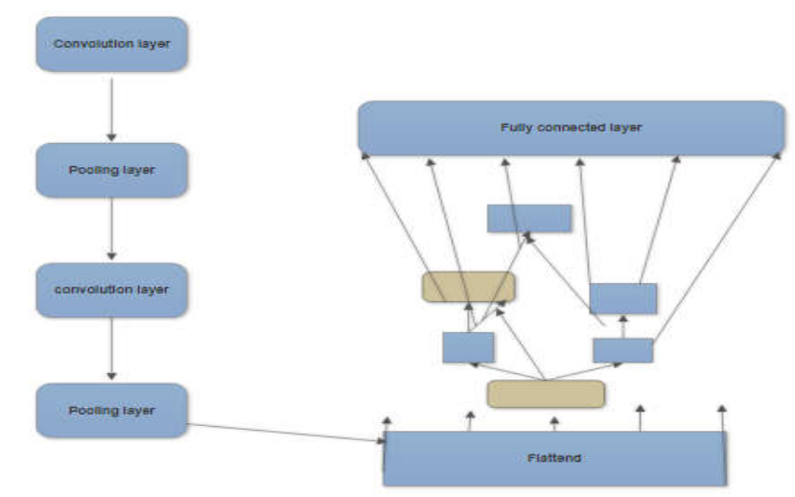
Image Referencing Style
While using the exiting diagrams from the other Authors work in your documentation, the following referencing style should be adopted.
For example, if you are interested to reuse the CNN Architecture from the exiting article specified as 10th Reference, the following notation should be adopted: “Figure 1. CNN Architecture (Courtesy: Source [10])”
Figure 1. CNN Architecture (Courtesy: Source [10])

